Slide 1

Processes

Slide 2


Chapter 3: Processes
Process Concept Process Scheduling Operations on Processes Cooperating Processes
Interprocess Communication Communication in Client-Server Systems

Slide 3


Process Concept
An operating system executes a variety of programs: Batch system – jobs
Time-shared systems – user programs or tasks
Textbook uses the terms job and process almost interchangeably
Process – a program in execution; process execution must progress in sequential fashion
A process includes:
program counter stack
data section

Slide 4

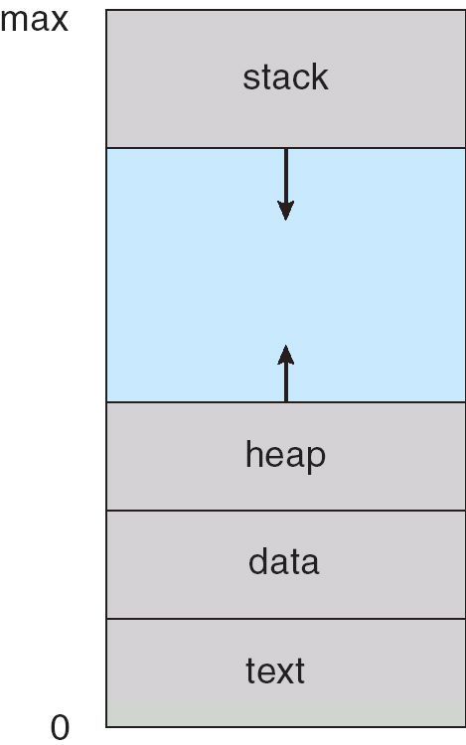
3.01

Slide 5



Process State
As a process executes, it changes state
new: The process is being created
running: Instructions are being executed
waiting: The process is waiting for some event to occur
ready: The process is waiting to be assigned to a processor
terminated: The process has finished execution

Slide 6

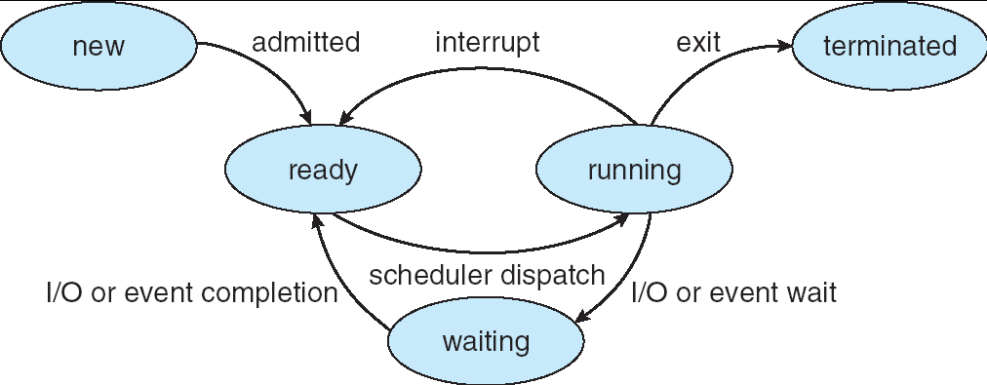
Diagram of Process State

Slide 7

Process Control Block (PCB)
Information associated with each process Process state
Program counter CPU registers
CPU scheduling information Memory-management information Accounting information
I/O status information

Slide 8

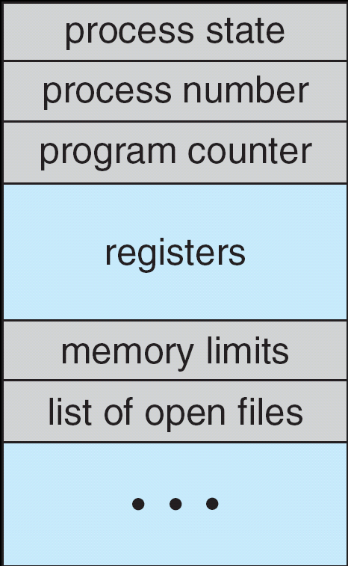
Process Control Block (PCB)

Slide 9

Process Scheduling Queues
Job queue – set of all processes in the system
Ready queue – set of all processes ready and waiting to execute Device queues – set of processes waiting for an I/O device Process migration between the various queues

Slide 10
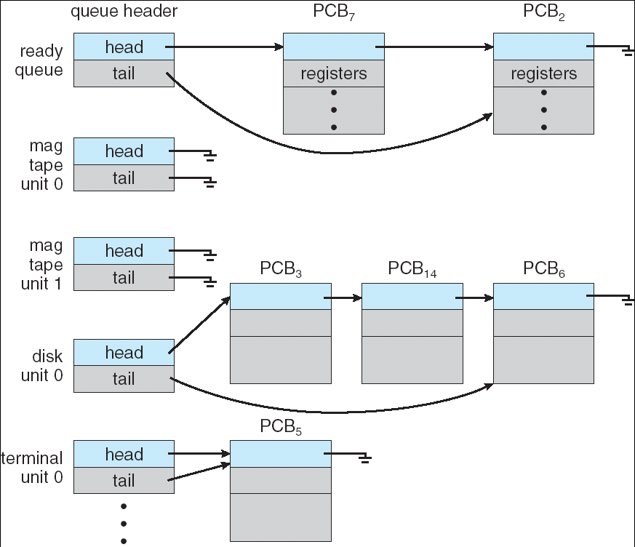
Ready Queue And Various I/O Device Queues

Slide 11

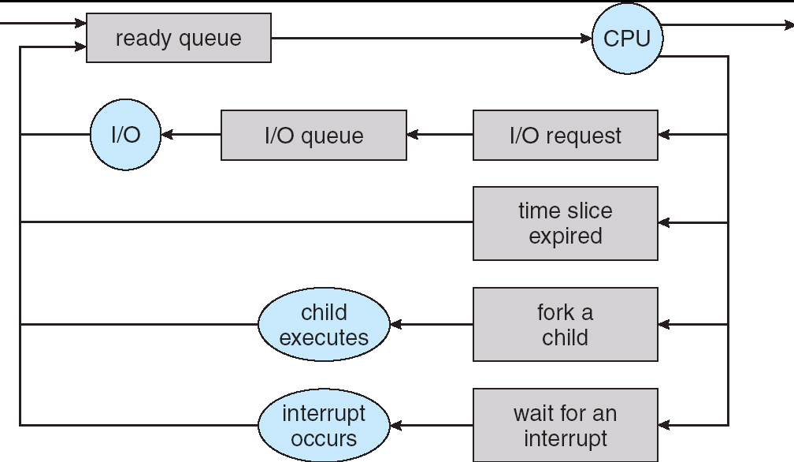
Representation of Process Scheduling

Slide 12

Schedulers
Long-term scheduler (or job scheduler) – selects which processes should be brought into the ready queue
Short-term scheduler (or CPU scheduler) – selects which process should be executed next.

Slide 13

Schedulers (Cont.)
Short-term scheduler is invoked very frequently (milliseconds) ⇒
(must be fast)
Long-term scheduler is invoked very infrequently (seconds, minutes) ⇒ (may be slow)
The long-term scheduler controls the degree of multiprogramming
Processes can be described as either:
I/O-bound process – spends more time doing I/O than computations, many short CPU bursts
CPU-bound process – spends more time doing computations; few very long CPU bursts

Slide 14

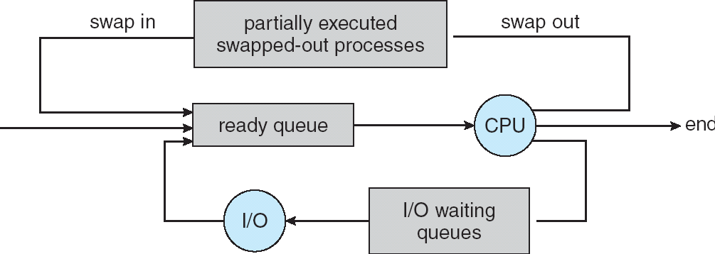
Addition of Medium Term Scheduling

Slide 15

Context Switch
When CPU switches to another process, the system must save the state of the old process and load the saved state for the new process
Context Switching involves storing the context or state of a process so that it can be reloaded when required and execution can be resumed from the same point as earlier. This is a feature of a multitasking operating system and allows a single CPU to be shared by multiple processes.
Context-switch time is overhead; the system does no useful work while switching
Dependent on hardware support

Slide 16

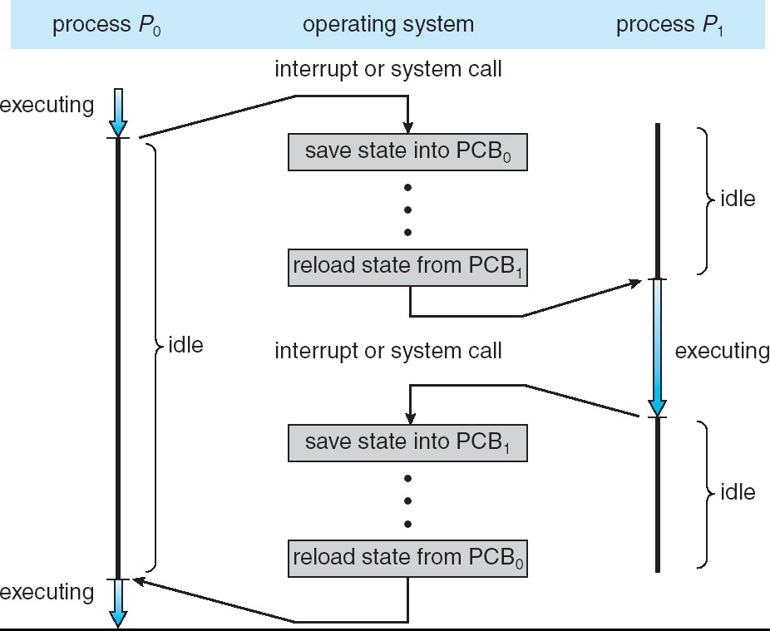
CPU Switch From Process to Process

Slide 17

Operations on process
Creation: This is the initial step of process execution activity. Process creation means the construction of a new process for the execution. This might be performed by system, user or old process itself. There are several events that leads to the process creation. Some of the such events are following: 1.When we start the computer, system creates several background processes.
A user may request to create a new process.
A process can create a new process itself while executing.
Batch system takes initiation of a batch job.

Slide 18

2. Scheduling/Dispatching: The event or activity in which the state of the process is changed from ready to running. It means the operating system puts the process from ready state into the running state. Dispatching is done by operating system when the resources are free or the process has higher priority than the ongoing process. There are various other cases in which the process in running state is preempted and process in ready state is dispatched by the operating system.

Slide 19
3. Blocking: When a process invokes an input-output system call that blocks the process and operating system put in block mode. Block mode is basically a mode where process waits for input- output. Hence on the demand of process itself, operating system blocks the process and dispatches another process to the processor. Hence, in process blocking operation, the operating system puts the process in ‘waiting’ state.

Slide 20
4. Preemption: When a timeout occurs that means the process hadn’t been
terminated in the allotted time interval and next process is ready to execute, then the operating system preempts the process.
This operation is only valid where CPU scheduling supports preemption.
Basically this happens in priority
scheduling where on the incoming of high priority process the ongoing process is preempted. Hence, in process preemption
operation, the operating system puts the process in ‘ready’ state

Slide 21

5.Termination: Process termination is the activity of ending the process. In other words, process termination is the relaxation of computer resources taken by the process for the execution. Like creation, in termination also there may be several events that may lead to the process termination. Some of them are:
Process completes its execution fully and it
indicates to the OS that it has finished.
Operating system itself terminates the process due
to service errors.
There may be problem in hardware that terminates the process.
One process can be terminated by another
process.

Slide 22

Process Creation
Parent process create children processes, which, in turn create other processes, forming a tree of processes
Resource sharing
Parent and children share all resources
Children share subset of parent’s resources Parent and child share no resources
Execution
Parent and children execute concurrently Parent waits until children terminate

Slide 23

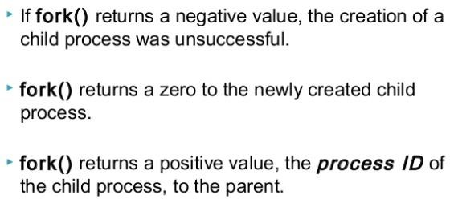
Process Creation (Cont.)
Address space
Child duplicate of parent
Child has a program loaded into it UNIX examples
fork system call creates new process
exec system call used after a fork to replace the process’ memory space with a new program

Slide 24

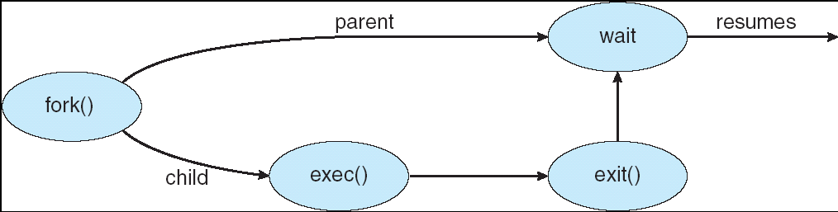
3.11

Slide 25

Process Termination
Process executes last statement and asks the operating system to terminate it (exit)
Output data from child to parent (via wait)
Process’ resources are deallocated by operating system Parent may terminate execution of children processes (abort)
Child has exceeded allocated resources Task assigned to child is no longer required If parent is exiting
 Some operating system do not allow child to continue if its parent terminates
– All children terminated - cascading termination

Slide 26

Cooperating Processes
Independent process cannot affect or be affected by the execution of another process
Cooperating process can affect or be affected by the execution of another process
Reasons for providing an environment that allows process cooperation
Information sharing Computation speed-up Modularity
Convenience

Slide 27
Cooperating Processes The concurrent processes executing in the operating system may be either independent processes or cooperating processes. A process is independent if it cannot affect or be affected by the other processes executing in the system. Clearly, any process that does not share any data (temporary or persistent) with any other process is independent. On the other hand, a process is cooperating if it can affect or be affected by the other processes executing in the system. Clearly, any process that shares data with other processes is a cooperating process.

Slide 28
Advantages of process cooperation Information sharing: Since several users may be interested in the same piece of information (for instance, a shared file), we must provide an environment to allow concurrent access to these types of resources. Computation speedup: If we want a particular task to run faster, we must break it into subtasks, each of which will be executing in parallel with the others. Such a speedup can be achieved only if the computer has multiple processing elements (such as CPUS or I/O channels).
Modularity: We may want to construct the system in a modular fashion, dividing the system functions into separate processes or threads Convenience: Even an individual user may have many tasks on which to work at one time. For instance, a user may be editing, printing, and compiling in parallel. Concurrent execution of cooperating processes requires mechanisms that allow processes to communicate with one another and to synchronize their actions

Slide 29


Interprocess Communication (IPC)
Mechanism for processes to communicate and to synchronize their actions
Message system – processes communicate with each other by passing of messages.
IPC facility provides two operations:
send(message) receive(message)
Messages can be of 2 types: Fixed length, variable length.
If P and Q wish to communicate, they need to: establish a communication link between them exchange messages via send/receive
Implementation of communication link
physical (e.g., shared memory, hardware bus) logical (e.g., logical properties)

Slide 30
Several methods for logically implementing a link and the send/receive operations. For example:
Direct or indirect communication
Symmetric or asymmetric communication

Slide 31

Implementation Questions
How are links established?
Can a link be associated with more than two processes?
How many links can there be between every pair of communicating processes?
What is the capacity of a link?
Is the size of a message that the link can accommodate fixed or variable?
Is a link unidirectional or bi-directional?

Slide 32

Direct Communication
Processes must name each other explicitly:
send (P, message) – send a message to process P
receive(Q, message) – receive a message from process Q Properties of communication link
Links are established automatically
A link is associated with exactly one pair of communicating processes
Between each pair there exists exactly one link
The link may be unidirectional, but is usually bi-directional

Slide 33

A variant of this scheme employs asymmetry in addressing. Only the sender names the recipient; the recipient is not required to name the sender.
receive (id, message) - Receive a message from any process; the variable id is set to the name of the process with which communication has taken place.

Slide 34

Indirect Communication
Messages are directed and received from mailboxes (also referred to as ports)
Each mailbox has a unique id
Processes can communicate only if they share a mailbox Properties of communication link
Link established only if processes share a common mailbox
A link may be associated with many processes
Each pair of processes may share several communication links
Link may be unidirectional or bi-directional

Slide 35

Indirect Communication
Operations
create a new mailbox
send and receive messages through mailbox destroy a mailbox
Primitives are defined as:
send(A, message) – send a message to mailbox A
receive(A, message) – receive a message from mailbox A

Slide 36

Indirect Communication
Mailbox sharing
P₁, P₂, and P₃ share mailbox A P₁, sends; P₂ and P₃ receive Who gets the message?
Solutions
Allow a link to be associated with at most two processes
Allow only one process at a time to execute a receive operation
Allow the system to select arbitrarily the receiver. Sender is notified who the receiver was.

Slide 37

Synchronization
Message passing may be either blocking or non-blocking
Blocking is considered synchronous
Blocking send has the sender block until the message is received
Blocking receive has the receiver block until a message is available
Non-blocking is considered asynchronous
Non-blocking send as the sender sends the message and continue
Non-blocking receive has the receiver receive a valid message or null

Slide 38

Buffering
Queue of messages attached to the link; implemented in one of three ways
Zero capacity – 0 messages
Sender must wait for receiver (rendezvous)
Bounded capacity – finite length of n messages Sender must wait if link full
Unbounded capacity – infinite length Sender never waits

